Slide 1




Image Captioning Project On Medical Images(x-rays)
Unlocking hidden potential in AI

Slide 2
CONTENTS
1
Problem Statement
2
About Dataset
3
Text & Data Preprocessing
4
Modeling Approach and Result

Slide 3

01
Problem Statement and
Business Use Cases

Slide 4
Problem Statement and Business Use Cases
Develop an automated system for generating accurate and descriptive captions for medical X-ray images. This system aims to assist healthcare professionals in interpreting and documenting findings efficiently and accurately.
Provide automated descriptions
Enhance medical education
Medical reporting and patient records
Facilitate telemedicine consultations

Slide 5
About Dataset
The Radiology Objects in Context (ROCO) dataset is a large-scale, multimodal imaging dataset sourced from PubMed Central Open Access publications. Each image is accompanied by a descriptive caption, keywords, and UMLS Semantic Types and Concept Unique Identifiers (CUIs). It supports the development of generative models for image captioning, classification models for image categorization, and content-based image retrieval systems in medical imaging research.
02

Slide 6
03
Text
&
Data Preprocessing

Slide 7
Text & Data Preprocessing
Lower Case
Remove links and Remove next lines (\n)
Words containing numbers
Extra spaces
Special characters
Removal of stop words
Stemming
Lemmatizatio

Slide 8
Image Preprocessing
Resize images to a uniform size.
Normalize pixel values to typically range between 0 and 1.
Apply data augmentation techniques such as rotations or flips.
Text Preprocessing
Tokenize captions into words or subwords.
Build a vocabulary from the tokens.
Convert words to numerical indices for model input.

Slide 9
Modeling Approach
Model 1 -Image Captioning with
Causal Language Modeling
04
Model Type
Utilizes a Causal Language Modeling approach.
Objective
Predicts next tokens in sequences for text generation.
Application
Generates descriptive captions for medical images.
Components
Includes pre-trained model fine-tuned on medical datasets.

Slide 10
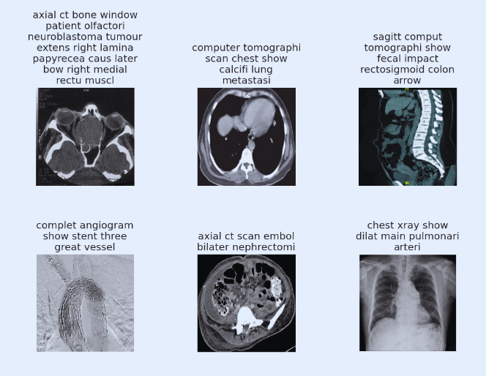

Slide 11
Modeling Approach
Model 2 - Image Captioning Using Deep Learning
Utilizes a multimodal approach integrating DenseNet201 for image features and LSTM for sequence modeling.
Generates descriptive captions for medical images by predicting sequences of tokens.
Enhances medical image understanding and reporting through automated caption generation.
DenseNet201 extracts image features, LSTM processes these features and tokenized captions to generate coherent medical image descriptions, fine-tuned on medical datasets for domain-specific nuances

Slide 12
Modeling Approach
Model 3 - Image Captioning Using Multimodal Deep Learning Architecture
Integrates two input streams — DenseNet201-extracted image features and tokenized captions.
Applies batch normalization and a dense layer (512 units) with ReLU activation.
Embeds tokenized sequences using a pre-trained embedding matrix with batch normalization, processed through a bidirectional LSTM.
Concatenates image features and caption representations, followed by dense layers (512 units) and a final softmax layer for vocabulary prediction.
Optimized with Adam optimizer.

Slide 13
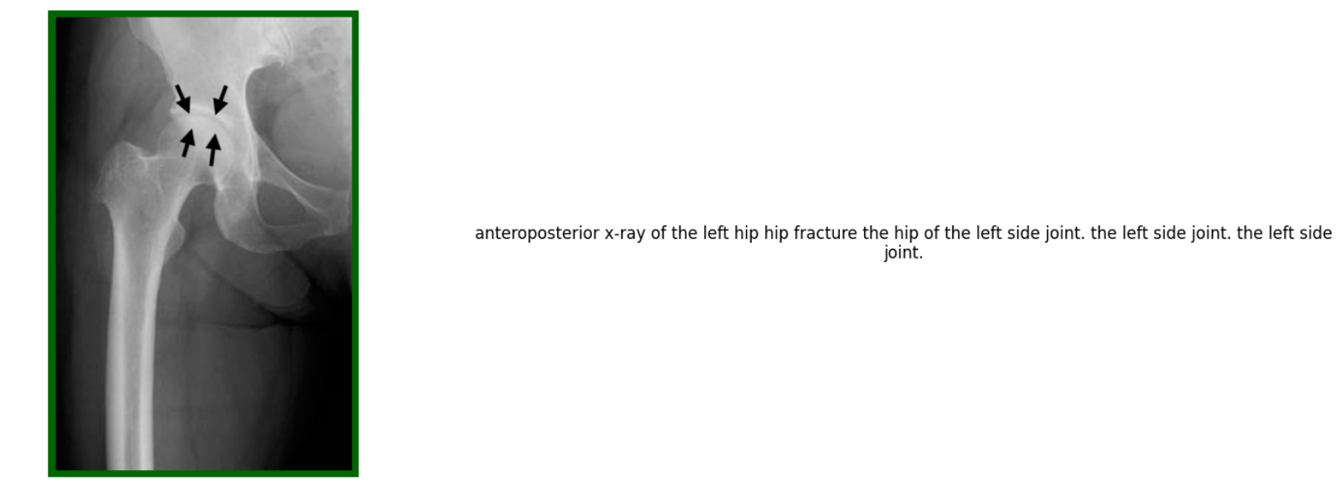

Slide 14
THANK YOU

